Slide 1
Match Issues
Rachel Brown
Associate Dean for Student Programs
Notes:
So, I used to do this in January, and this year, I’ll do one now, and then the same again in January. Some of the user guides aren’t there yet on the website, and will become available in January for you and for us.

Slide 2
The School of Medicine does have a mistreatment policy
http://medicine.missouri.edu/handbook/diversity.php#mistreatment

Slide 3
You can make an anonymous complaint, comment or suggestion about your medical education
Go to www.muhealth.org and click on “Make a Comment”

Slide 4
Please complete the annual survey and the graduation questionnaire
You will receive information about both soon. Please provide us with feedback about your medical education

Slide 5
Goals
Brief Introduction to the Match and how it works
Answer Common Questions
Help you to Avoid Common Mistakes
Advice on the Scramble (just in case)

Slide 6

2012 MATCH: INFORMATION ABOUT RANK ORDER LISTS AND NRMP POLICY
Notes:
6
These slides display the step-by-step process for creating and certifying the rank order lists that will be used in the Match and highlight important policy information
These slides are based on 2012 info as 2013 Match info has not yet been posted by NRMP. When it is, we will make it available to the class. We do not expect major changes. The main match will use the same system as in previous years.

Slide 7
Getting Started with your ROL
Review the webcast: Creating a Rank Order List - http://www.nrmp.org/rol2012.pdf
Review ROL section of User Guide - http://www.nrmp.org/res_match/userguide/2012_applicant.pdf
Use your AAMC ID and password to log in to the NRMP’s secure, web-based Registration, Ranking, and Results (R3) system
Couples must register both partners’ AAMC IDs in their NRMP files
Your NRMP/AAMC ID and your ERAS/AAMC ID must be the same
Notes:
7
The Applicant User Guide can be found at www.nrmp.org. Select Residency Match / User Guides / Applicant User Guide 2012. We will update these web links once NRMP posts the 2013 info in January.
Make sure your NRMP and ERAS AAMC IDs are the same; if they do not match, contact the NRMP immediately.

Slide 8
Definitions
Match Status: ACTIVE Registered
RANKING ROL started
CERTIFIED ROL ROL finished
Fee Status: PAID No fees due
Credentials: VERIFIED By school
(US, Osteo, Canadian applicants)
ECFMG Status: VERIFIED By ECFMG
(IMGs & 5th Pathway applicants)
Notes:
An applicant becomes ACTIVE after he/she Updates My Profile, accepts the Terms and Conditions of the Match, and pays the registration fee.
Additional fees are incurred if participating as a couple ($15/partner) or submitting a rank order list with more than 20 programs ($30/rank >20). For couples, additional fees are incurred when a partner ranks more than 30 unique programs. These fees must be paid at the time they are incurred or the next time the applicant logs into R3. Fees are not refundable.
US allopathic, osteopathic, 5th Pathway, and Canadian applicants have their graduation verified by their schools.
International medical school and 5th Pathway applicants have their credentials verified by ECFMG.

Slide 9
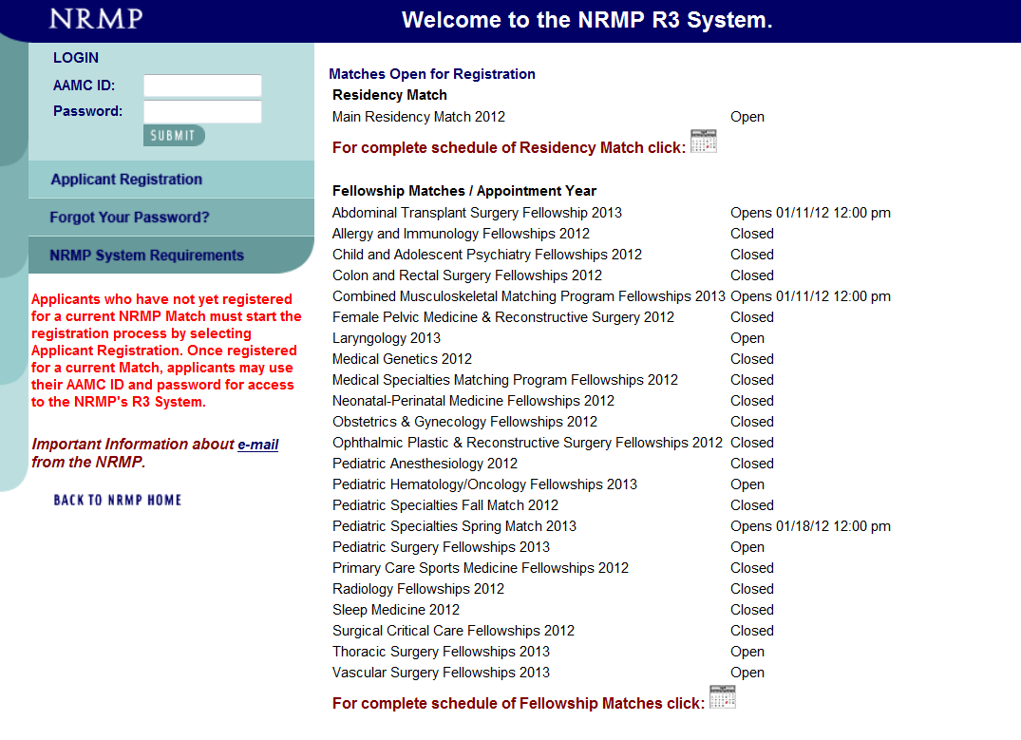
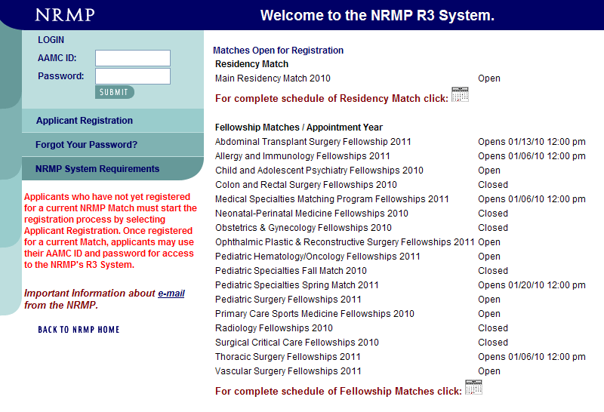
Notes:
9
Go to the NRMP Home Page (www.nrmp.org)
Select Register / Login
Use your AAMC ID and password to access the NRMP’s Registration, Ranking and Results (R3) system
If you forgot your password, contact the NRMP or click on “Forgot Your Password?” and follow the instructions. You must correctly answer your security questions to obtain a new temporary password.

Slide 10
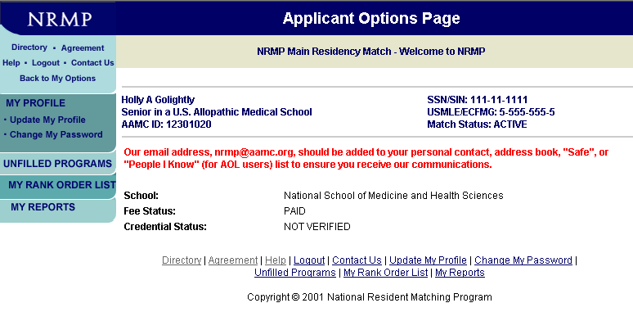
Notes:
You can modify your profile information. From the left menu bar, click on “Update My Profile” and then click “Edit”.

Slide 11
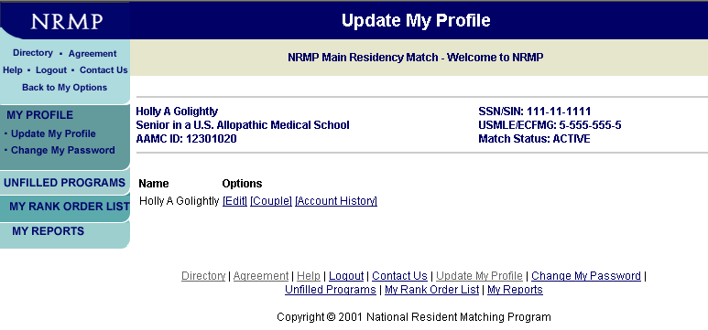
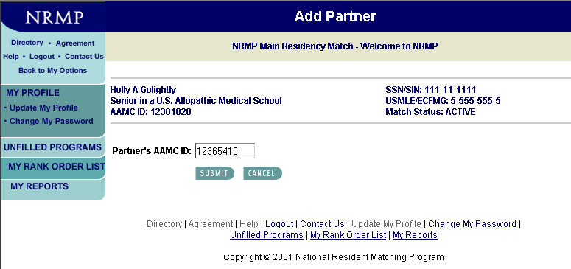
Notes:
From the Update My Profile screen you can edit your biographical information and/or register for the Match as a member of a couple.
If you are participating as a member of a couple, you must add your partner by clicking on “Couple”. Then enter your partner’s AAMC ID and click “Submit”.
Your partner’s name will appear. Click on “Submit” at the bottom of the screen to confirm your partner.
The $15 per partner couple’s fee should be paid on-line at the time you register as a couple by clicking on “Balance Due” which will appear on the Update My Profile screen after coupling.

Slide 12
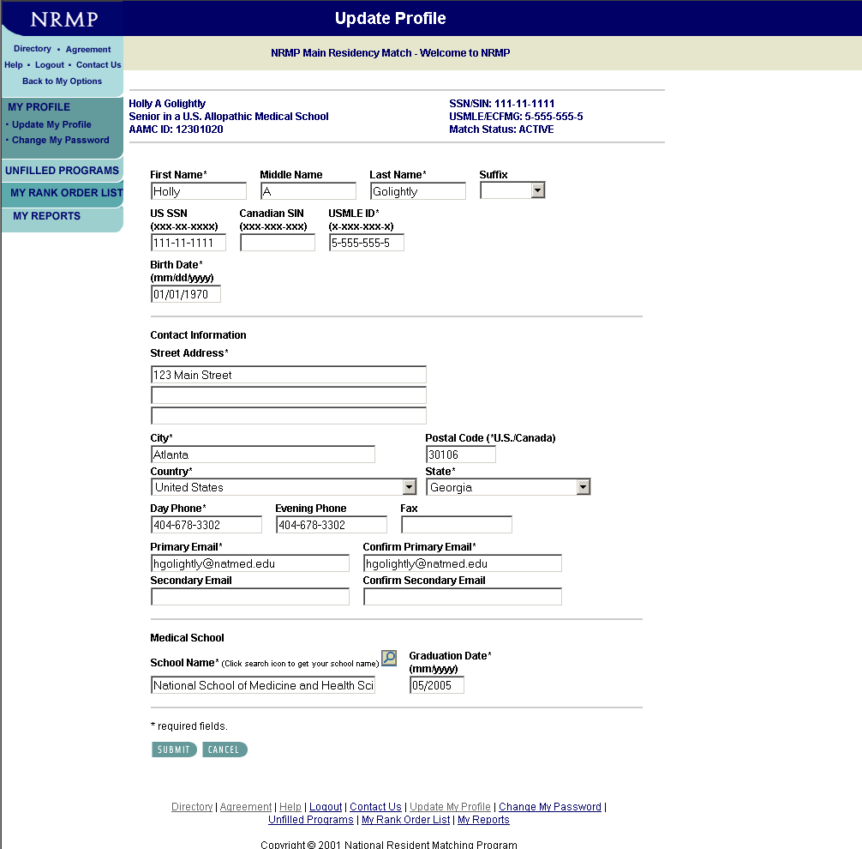
Notes:
E-mail is the primary means of communication from NRMP. Keep your e-mail address current!
NRMP sends bulk e-mail messages to applicants which some internet providers (i.e. Gmail, Hotmail, Yahoo and AOL) may classify as junk mail. Turn off any junk mail filters and/or add nrmp@aamc.org to your address book or list of “trusted” or “safe” addresses so you will not miss receiving messages from NRMP.

Slide 13
Email Problems
Not keeping your email current
Your email box is full
Not turning off your junk mail
Add nrmp@aamc.org to your SAFE addresses

Slide 14
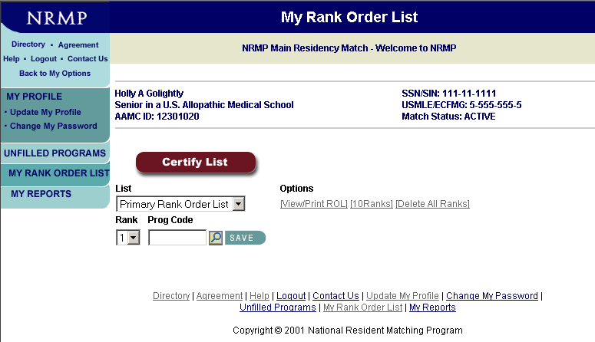
Notes:
To create your rank order list, click on “My Rank Order List” from the left menu bar.
You can enter one rank at a time by entering the program code in the “Prog Code” box, or up to 10 ranks at a time if you select “10 Ranks.”
You can add programs at different times.
You can mix advanced, categorical, and preliminary programs, as well as specialties and geographic locations, on your primary rank order list.
To search for the NRMP code of a program you wish to rank, click on “Directory” in the upper left corner of the screen or on the magnifying glass icon next to the “SAVE” button.
For Help, click on “Help” in the upper left corner of the screen. You can then search the contents of the User Guide.

Slide 15
Questions?
You can add programs at different times
You can mix advanced, categorical, preliminary year programs
You can mix specialties
You can mix geographical locations
You can move them around

Slide 16
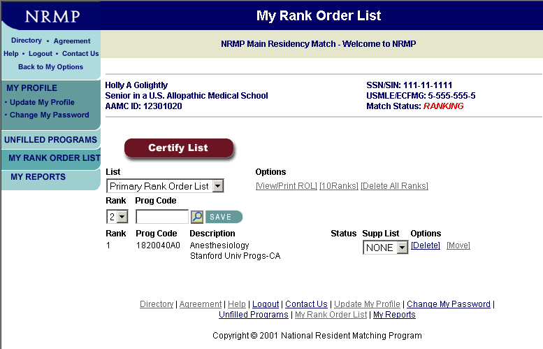
Notes:
When an advanced program is entered on the primary rank order list, a box appears under “Supp List.”
The applicant must create a supplemental list of preliminary or transitional programs for the PGY-1 year of training.
Supplemental rank order lists are used in the Match only if the applicant is matched to an advanced program linked to that supplemental list. Supplemental rank order lists are NOT linked for applicants participating in the Match as a couple!
For your first supplemental list, select “New” from the dropdown list under “Supp List” and a new screen will appear automatically.

Slide 17
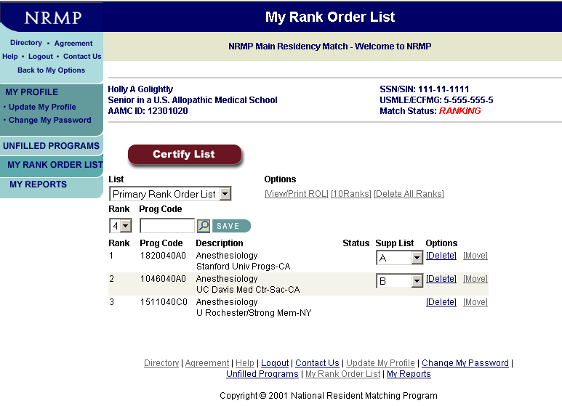
Notes:
Attach a supplemental list to each advanced program on your primary rank order list or select “NONE” if one is not needed.
This applicant is using different lists (A and B) for his two advanced programs. List A would have PGY-1 programs in the Stanford area of California while List B would have programs in the Sacramento area of California. However, the same supplemental list could be used for all advanced programs ranked.
You can delete programs by clicking on the “Delete” link under Options.
You can change the order of programs on your rank order list by clicking the “Move” link under Options.

Slide 18
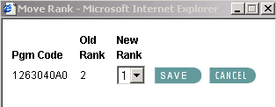
Notes:
Enter the new rank number for the program being moved (UC Davis) and click on “SAVE”.
The UC Davis program now is ranked number 1.
When you have completed your rank order list entry, you MUST certify it - telling the NRMP that your ROL is ready to be used in the Match.
Click on “Certify List”.

Slide 19
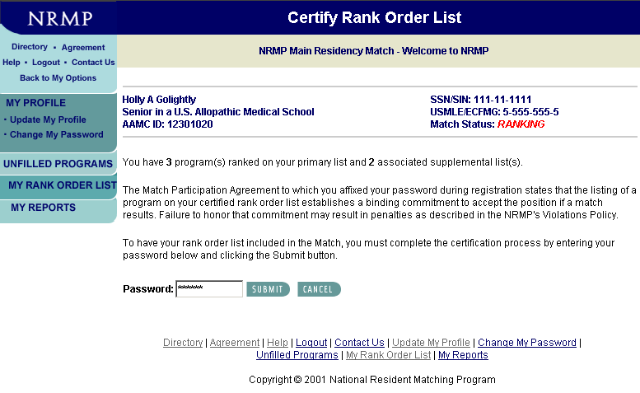
Notes:
To certify your ROL, enter your password and click on “Submit”.
Remember, when you certify your rank order list you enter into a binding commitment to accept a position should a match occur and to begin training on the date specified in the appointment contract. Failure to honor the commitment is a violation of the Match Participation Agreement you signed when you registered for the Match. Information on NRMP policy is discussed later in this presentation.

Slide 20
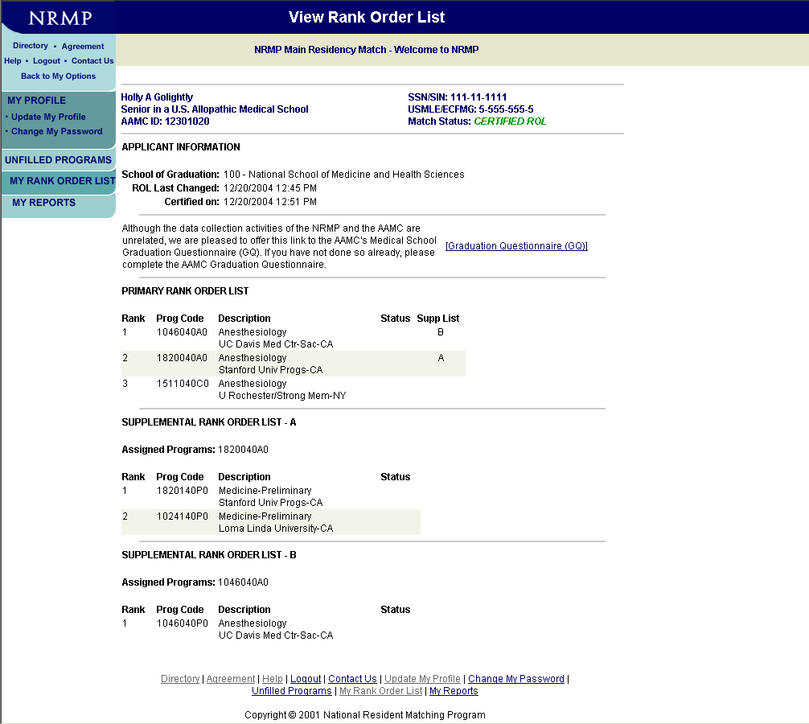
Notes:
Your complete rank order list will be displayed on the View Rank Order List page. Note that your Match Status has changed from “Ranking” to “Certified ROL” which is displayed in green at the top of the page.
NRMP recommends that you print a copy of your list using the print function on your browser or the View/Print ROL link on the My Rank Order List page.
You can make changes to your list after it is certified, up until the rank order list deadline, but you must re-certify it after each change.
Please note that the System does NOT save any version(s) of previously certified rank order lists. It saves only the version you see on the My Rank Order List page.
When ANY change is made, your list returns to ranking status and there is NO record of that earlier certified list. You MUST re-certify your list before the deadline for it to be used in the Match.
The ranking deadline is 9:00 p.m. eastern time on Wednesday, February 22. Your list must be certified at that time.
Remember: THE NRMP WILL NOT ADD, DELETE, OR MOVE PROGRAMS OR IN ANY WAY MODIFY A RANK ORDER LIST AFTER THE DEADLINE HAS PASSED.

Slide 21
Couples Information
Any two applicants can couple. A $15 per partner couples fee must be paid.
30 unique programs can be ranked by each partner before extra rank fees apply.
Each partner enters his/her own list. Lists MUST have same number of ranks.
Applicants participating as couple can rank same program more than once.
Up to applicants what constitutes an acceptable pair of programs. NRMP does not check this.
Use special code (999999999) to indicate when one partner is willing to go unmatched if other partner matches. Code should be used at bottom of lists when other acceptable program pairs exhausted.
Couples matching done on PRIMARY list only – supplemental rank order lists are NOT linked.
Notes:
Couples in the Algorithm:
Lists considered together as a unit
BOTH partners must match at same rank or algorithm continues
Couples can “half-match” when code 99999999 (‘No Match’) code is used

Slide 22
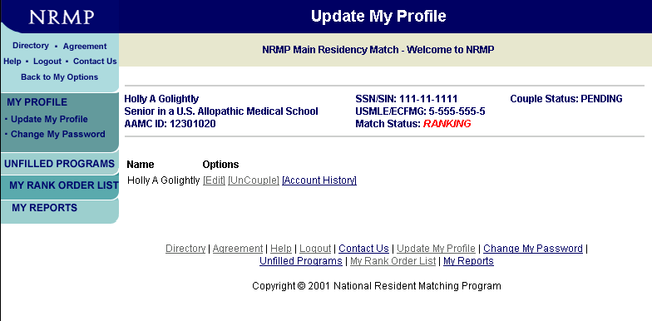
Couples Verification
Notes:
How to confirm that you’re participation in the Match as a couple:
Each partner must pay $15 ($30 combined) to participate in the Match as a couple
Couple status will read ‘APPROVED’ when both partners have designated each other to participate together in the Match as a couple. Status will read ‘PENDING’ status when only one partner has designated/“coupled” with another person.

Slide 23
You can change your list up until the rank order deadline
Remember, the Match is a binding legal commitment

Slide 24
NRMP Fees
Registration fee $50
Couples $15 per partner
Late registration $50 additional (after Nov 30)
Primary ROL 1-20 programs: No charge
Additional programs $30 per program ranked
Supplemental ROL(s) 1-20 programs: No charge
Additional programs $30 per program ranked on all
supplemental lists combined
Couples ROL 30 programs before extra
fees are charged
Notes:
24
Applicants pay a $50 registration fee; there is a $50 late fee after November 30.
Couples pay an additional $15 per partner.
1-20 programs may be ranked on your primary rank order list at no additional charge; each additional ranked program costs $30 per program.
1-20 programs may be ranked on your supplemental rank order list(s) at no additional charge; each additional ranked program on all supplemental lists combined costs $30 per program.
Couples may rank 1-30 programs at no additional charge. Remember couples can list the same program more than once on their list depending upon the corresponding program on their partner’s list.
Extra fees will be due at the time of certification. Those fees are NOT refundable if you certify a shorter list at a later time.

Slide 25
Deadlines and Dates
January 15, 2013 Ranking opens in R3
January 31, 2013 Final program quotas
February 20, 2013 Ranking closes in R3
9:00 p.m. eastern (8:00 p.m. CST)
March 11, 2013 Did I Match?
noon eastern (11:00 a.m. CST)
March 11, 2013 List of Unfilled Programs --
noon eastern (11:00 a.m. CST) SOAP begins
March 15, 2013 Match Day
Notes:
25
On January 15, you can begin creating your rank order list.
On January 31, programs must notify the NRMP of the final number of positions (quota) that will be in the Match.
On February 20, the R3 system closes at 9:00 p.m. eastern time. You will not be able to create, change, or certify a rank order list after that time.
On March 11, you will receive an email from the NRMP to let you know whether you matched, but not to which program you matched.
On March 11 at noon eastern time, the list of unfilled programs will be available. Only SOAP eligible unmatched applicants, unfilled programs, and medical schools will have access to that information.
On March 15 at 1:00 p.m. eastern time, after the medical school’s Match Day ceremony, the program(s) to which you matched will be posted on the NRMP web site.

Slide 26
Mistakes
Undersell yourself (include a “reach” program)
Rank order list not long enough
Oversell yourself (no safety net program)
Charting Outcomes in the Match is available
at nrmp.org
See me for school-specific information

Slide 27
Top 5 Factors for Interview Selection
USMLE Step 1 Score
Letters of Recommendation
Personal Statement
Grades in required clerkships
USMLE Step 2 Score
Notes:
From the Program Director Survey, these are the top 5 factors Program Directors cited as criteria for Interview Selection… MSPE ranks #8, Class ranking #10

Slide 28
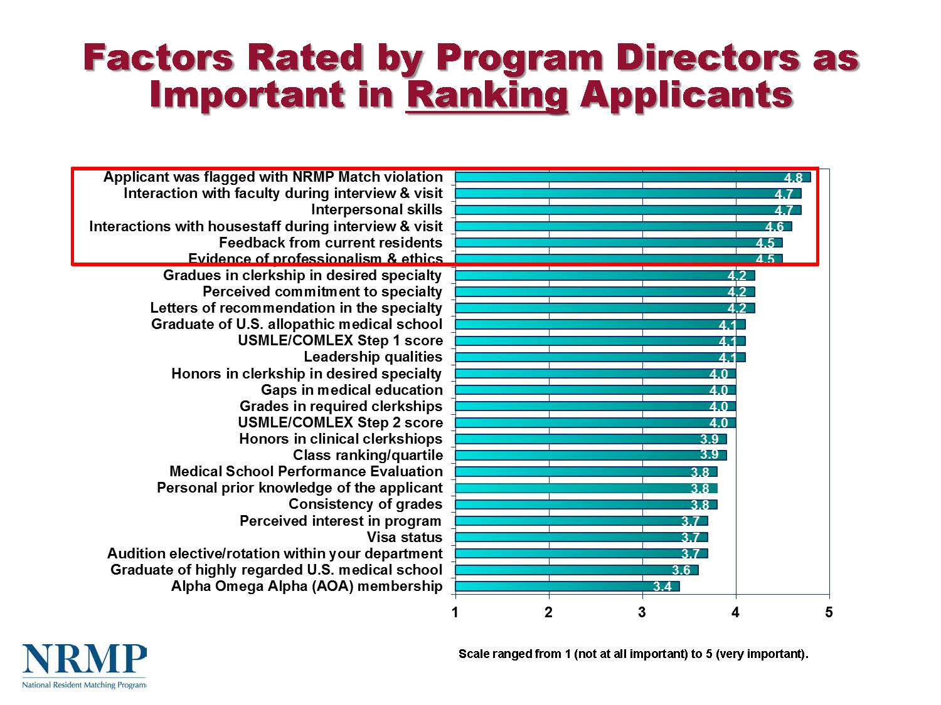

Slide 29
How does the Match algorithm work?
Lloyd Shapley and Alvin Roth
Notes:
Lloyd Shapley and Alvin Roth
Nobel Prize in economics
Matching theoryithm in which men and women rank each other as potential mates and a series of offer rounds produces a best match. The Gale-Shapley algorithm is the basis of the matching algorithm used by the NRMP, and Roth worked with NRMP to adapt it so that it proposes matches on the basis of the applicant rather than the program rank order lists. Roth also has applied the algorithm to the New York City schools, and research is underway to use it for kidney donors and patients who need transplants.

Slide 30
How the Match Algorithm Works
Applicant proposing
Starts with an attempt to place an applicant in the program ranked #1 by the applicant
A tentative Match occurs:
if the program also ranked the applicant and
the program has unfilled positions
if the program is filled but the applicant is ranked higher than another applicant tentatively matched to that program
Notes:
For a detailed explanation of the algorithm, see http://www.nrmp.org/res_match/about_res/algorithms.html

Slide 31
How the Match Algorithm Works
There is no match if:
the program did not rank the applicant
the program ranked the applicant but is filled with other applicants more preferred by the program
Matches are final when:
when the algorithm completes its cycles, all tentative matches become final
Couples match when:
the algorithm places a couple in their highest ranked pair of programs on the PRIMARY list where BOTH matched
Notes:
If a match does not occur at rank #1, the algorithm proceeds down the applicant’s list rank by rank until it finds a match or it runs out of ranks, in which case the applicant remains unmatched.

Slide 32
The Match Commitment
SECTION 5.1:
“The listing of an applicant by a program on its certified rank order list or of a program by an applicant on the applicant's certified rank order list establishes a binding commitment to offer or to accept an appointment if a match results and to begin training in good faith (i.e., with the intent to complete the program) on the date specified in the appointment contract.
Failure to honor this commitment by either party participating in a match will be a breach of this Agreement and may result in penalties to the breaching program or applicant…….”
Notes:
The NRMP recommends applicants consider carefully the programs they include on their rank order list. In certifying a rank order list, the applicant is entering into a contract with the NRMP to accept a position at ANY program should a match occur and to begin training on the date specified in the appointment contract. Failure to accept the position will subject the applicant to a violation investigation and could result in the levying of sanctions.

Slide 33
NEVER
NEVER
NEVER
RANK A PROGRAM YOU DON’T WANT TO GO TO

Slide 34
AGAIN ….NEVER

Slide 35
In limited circumstances, the NRMP may grant a waiver of the Match commitment.
Applicants:
Hardship
Change of specialty: must be requested by January 15
Completion of residency postponed
Waivers must be requested from, and can be granted only by, the NRMP.
Notes:
The NRMP allows for match commitments to be waived under special circumstances.
Hardship waivers may be granted to applicants facing unexpected, life-changing circumstances that would impede their ability to perform in a residency training program.
Change of specialty waivers may be granted to applicants who match to advanced (PGY-2) specialty positions and who wish to pursue a different specialty. Waiver requests MUST be submitted by January 15 prior to the start of training in order to be considered. Change of specialty waivers will NOT be granted to applicants who match to preliminary or categorical (PGY-1) positions that commence July 1 after the Match.
Waiver requests MUST be submitted in writing to the NRMP. Applicants and programs are NOT authorized to release each other from a match commitment.

Slide 36
Match Violations
You (and the program) are not allowed to ask where you’ll be ranked - though you can express interest and so can they
You aren’t allowed to discuss or accept a position outside the match before NRMP gives you a waiver
You must honor the match agreement
You must provide programs with complete and accurate information
Violations should be reported to the NRMP

Slide 37
FAMOUS EASTERN MEDICAL SCHOOL GENERAL HOSPITAL
Dear Applicant:
We have thoroughly enjoyed your visit with us and it is clear that you will excel wherever you choose to go.
You represent the kind of candidate that has traditionally done well in our program and we hope to have the opportunity to work with you in the coming year.
Yours sincerely,
Program Director
Notes:
Did the applicant who received this letter match to this program?
No - and this is taken from a real letter.
Be wary of such comments or letters. They are not binding. Do not put too much weight on them when preparing your rank order list.

Slide 38
Final Considerations
Once you have certified your rank order list ……forget about it for a few days.
Notes:
38
Once you have certified your rank order list - forget about it for a few days.

Slide 39
Summary
Prepare a rank order list worksheet with program codes in order of preference before entering them on the “My Rank Order List” screen.
Be sure to certify your rank order list.
Complete your list at least a week before the deadline.
Relax!

Slide 40
SUPPLEMENTAL OFFER AND ACCEPTANCE PROGRAM (SOAP)
Notes:
Replaces the Scramble

Slide 41
By Wednesday March 6
I will be asked to recertify you as eligible to participate in SOAP
Eligible means ready to start work on July 1 2013

Slide 42
On Friday March 8
You will all get an email saying you are eligible for SOAP whether or not you matched

Slide 43
SOAP replaces the Scramble
SOAP is not a second match. It is a series of offers by programs.
Applicants express preferences by applying to programs.
Programs express preferences with lists of applicants.
The R3 System offers positions to applicants in order of a program’s preference.
Applicants can receive multiple offers in any round.
Positions offered/accepted during SOAP establish a binding commitment enforced by the Match Participation Agreement.

Slide 44
On Monday March 11
11 a.m., we are available in OME for anyone who didn’t match
We can’t initiate contact with a program on behalf of student
But we can (and will) contact a program after you apply to a program and the program has contacted you

Slide 45
SOAP for students
Unmatched or partially matched eligible students
Can apply during Match Week
- To match-participating programs
- Using ERAS
And accept positions ONLY through SOAP
during Match week

Slide 46
You cannot use phone, fax, email, or other services
You cannot have another individual/entity contact a program
You cannot apply to non-Match participating programs till after Match Week

Slide 47
You will have access to the List of Unfilled Programs at 11 a.m. CST Monday
You can select programs using ERAS beginning noon Monday
Your ERAS applications will be transmitted beginning 1:00 pm CST Monday

Slide 48
First program offers will not be sent until 11 a.m. CST Wednesday (so Tuesday is interview-by-phone day)
You will receive offer notification by email
You will log in to R3 System to accept/reject offer
You will receive email notification when offer is accepted

Slide 49
Match Week
Monday 11 a.m. - “Did I Match?”
Unfilled positions list available
Noon – ERAS opens for your applications
1 p.m. - ERAS transmits applications
Tuesday - Applicant/program communicate
Wednesday noon – programs make offers; valid for 2 hours

Slide 50
You may receive more than one offer
Your acceptance of an offer is a binding legal agreement
If you don’t accept an offer, you won’t get it again

Slide 51
There will be several rounds of applications and offers, with the last one expiring on Friday at 4.00 p.m. CST
We (and NRMP) expect that most positions will go in the first or second round

Slide 52
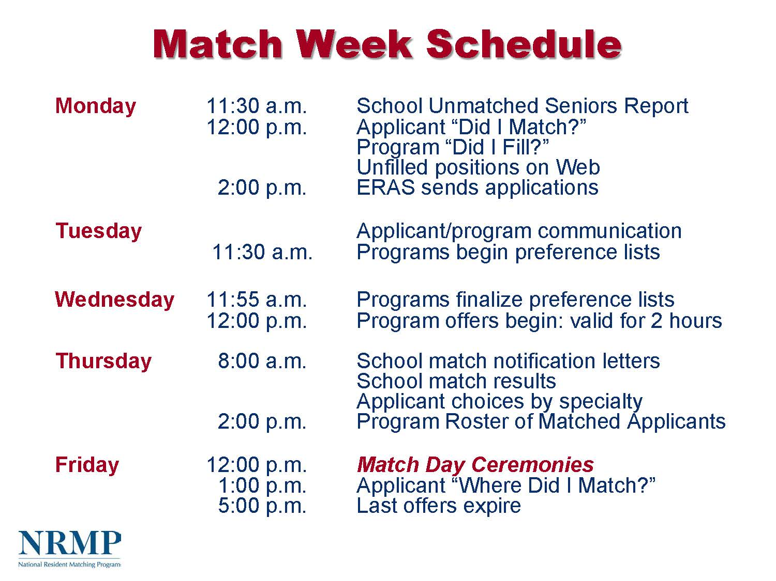
Match Week Schedule *EST
Notes:
*All times listed are EST. We will post a copy with CST.

Slide 53
Questions?

